Slide 1
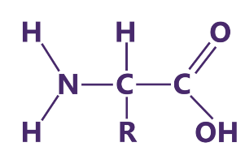
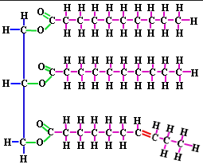
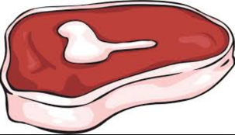
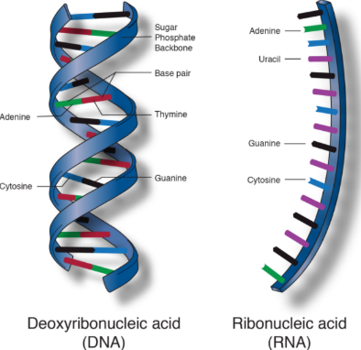
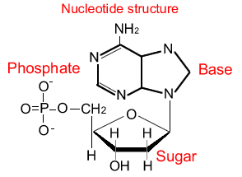
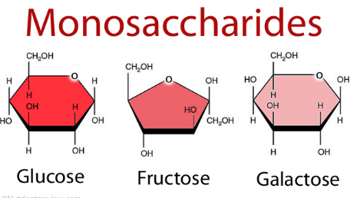
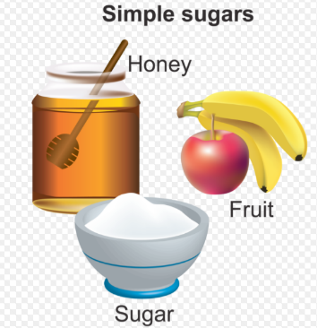
Building Blocks or Monomers
Building Blocks or Monomers
=
Triglycerides
E like a
Amino Acid
=
Builds Muscles
C.H.O.N
Storage for Energy & Insulation
C.H.O
Proteins
lipids
MacroMolecules
C.H.O
C.H.O.N.P
Complex Carbs
Carbohydrates
Nucleic Acid
Building Blocks or Monomers
=
Long term
DNA & RNA
Building Blocks or Monomers
=
Energy
Short term
IN ALL FOODS

